Slide 1
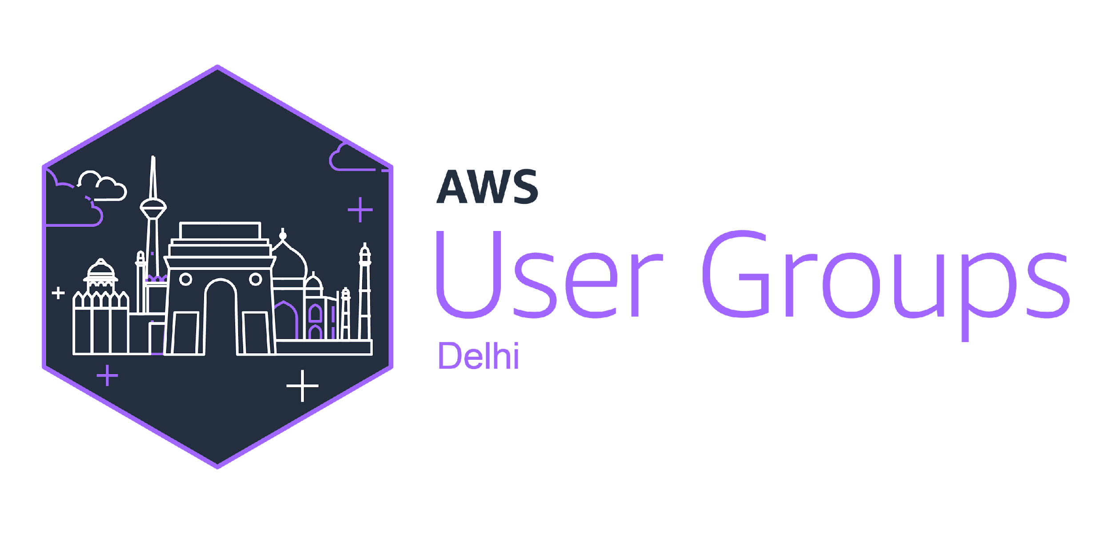
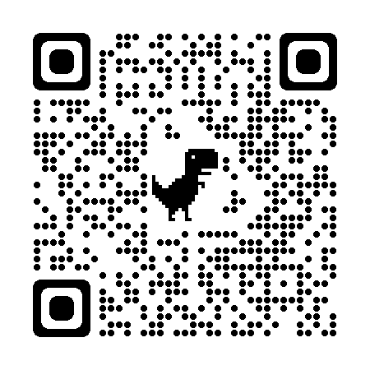
Empowering The AWS User Community with AWSUGNCR

Slide 2
Vision:
Amazon Web Services (AWS) Community User Groups (CUGs) aim to foster a global community of AWS enthusiasts and professionals.

Slide 3
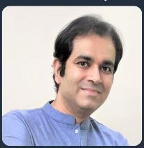
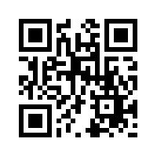
Rajat Arora (Vice President at Natwest)
17+ Years experience
Gitlab Certified DevOps Engineer
AWS Certified Solution Architect – Associate
AWS Community Builder
AWS UserGroup Leader AWSUGNCR
https://www.linkedin.com/in/rajat-arora-77308414/

Slide 4

Dipali Kulshrestha (Vice President at Natwest)
18+ Years experience
AWS Certified Solution Architect – Professional
AWS Certified Solution Architect – Associate
AWS Certified Cloud Practitioner
AWS Hero – AWS Community
AWS UserGroup Leader AWSUGNCR
AWS India Community Member
https://www.linkedin.com/in/dipalik/

Slide 5
Benefits of community:
Community Building
Feedback Loop
Bringing together individuals who share a common interest in AWS services and solutions
A channel to gather feedback from the tech communities
Knowledge Sharing
Advocacy
Continuous learning and deepen understanding around AWS.
Advocating adoption of Best practices with AWS Services
Networking
Diversity and Inclusion
Connect with like-minded people, collaborate & exchange Ideas
Welcoming all individuals from all backgrounds, regardless of their expertise

Slide 6
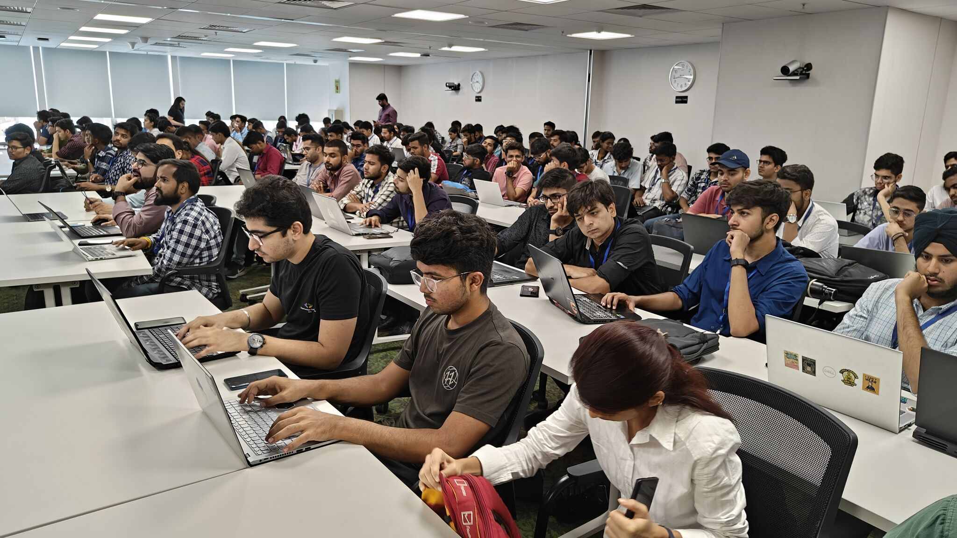
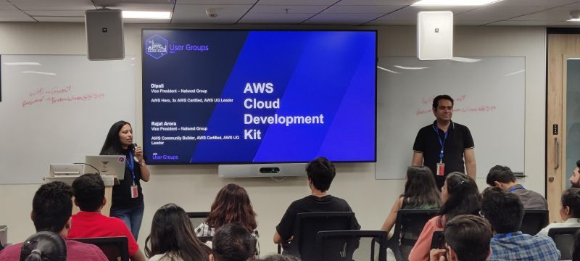
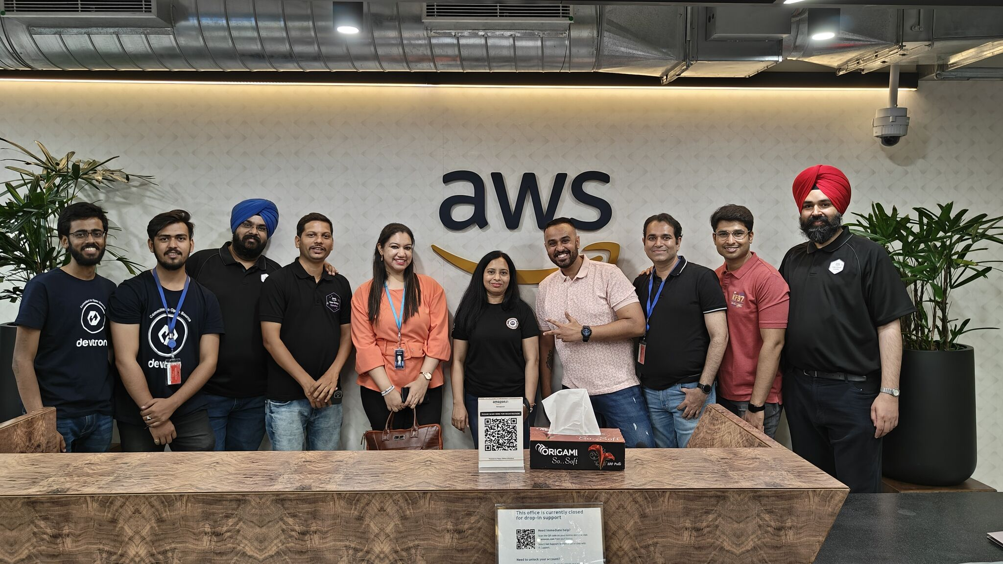
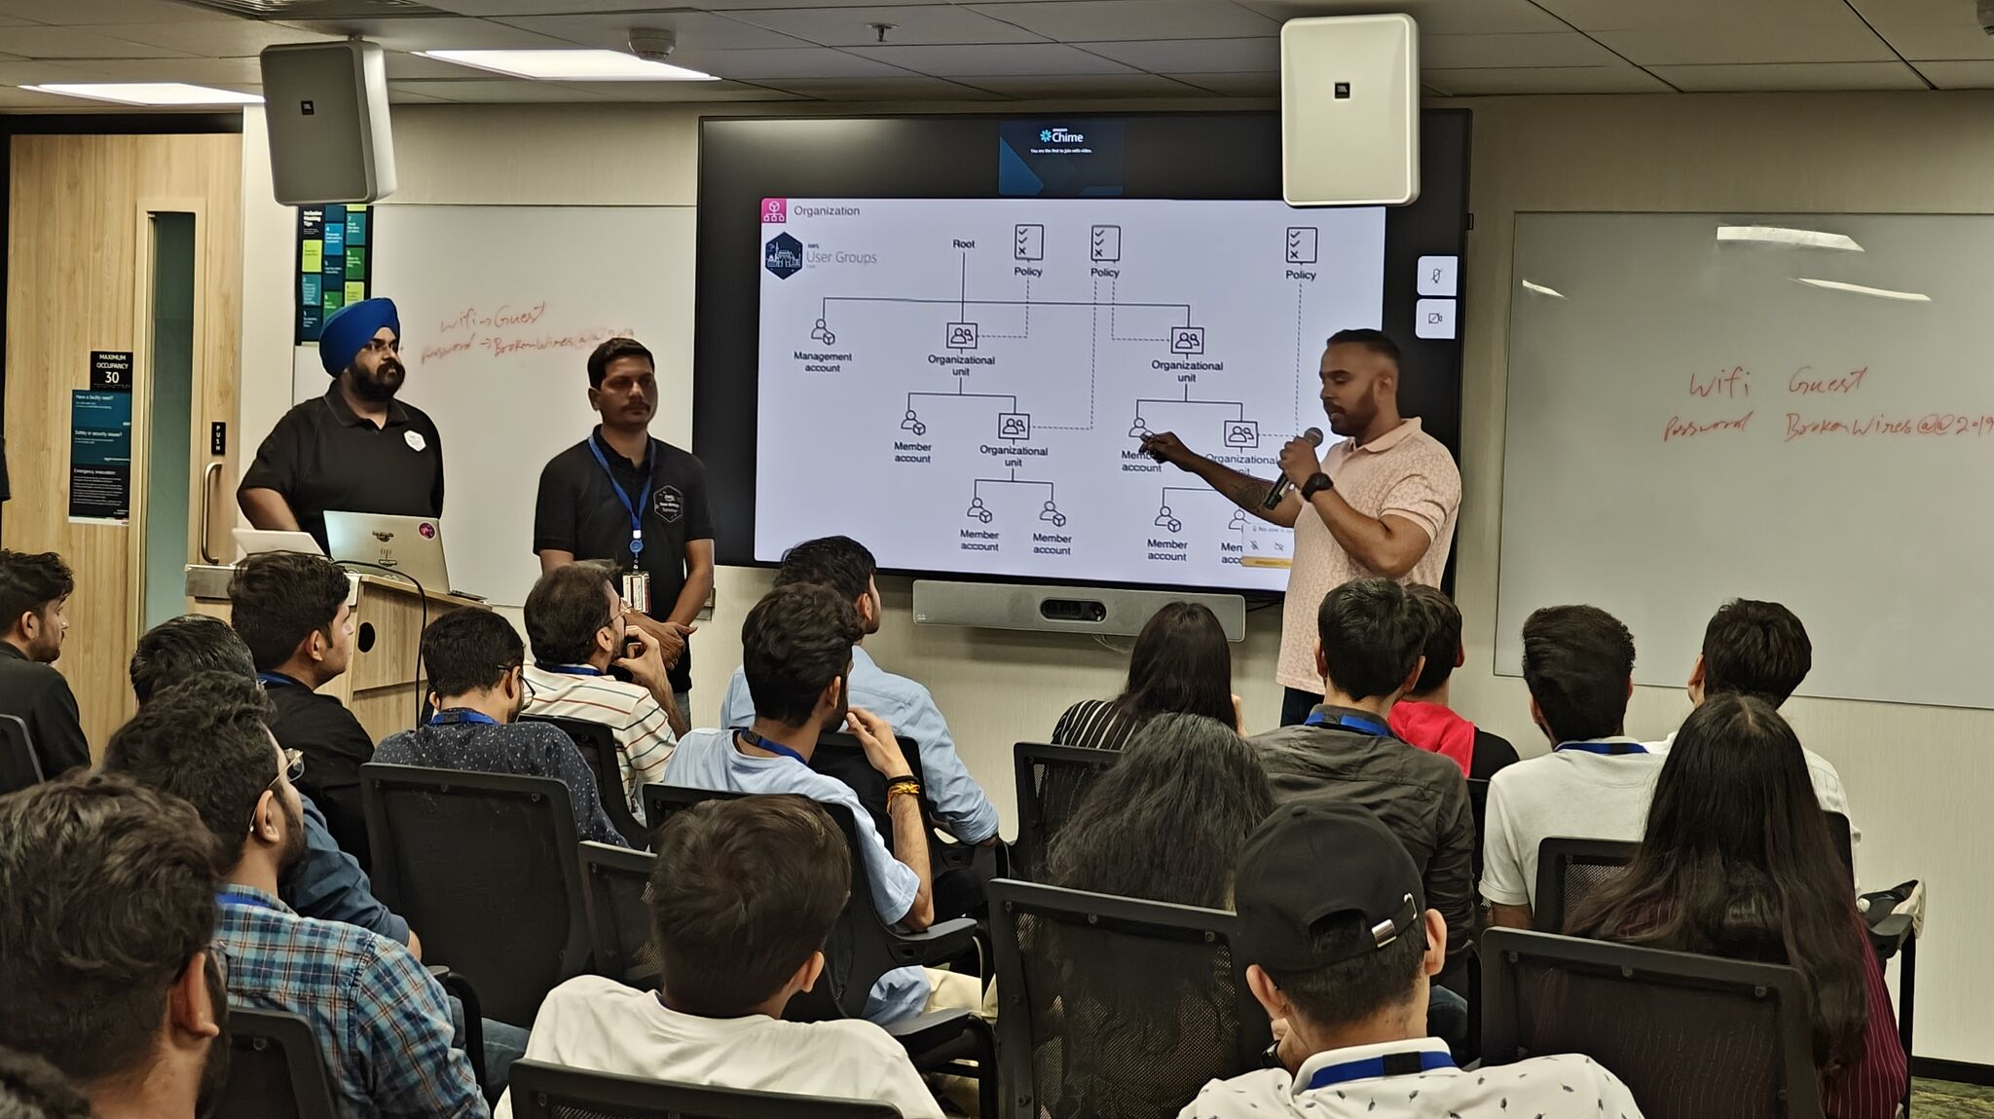
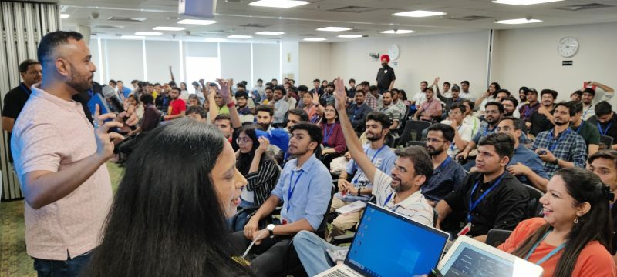
Past Events
Notes:
In 2023, we had a blast with AWS CDK Workshop, AWS Security Hub Workshop and several AWS Accelerated BootCamps.

Slide 7
Agenda:
Introduction to Cloud Computing
Introduction to AWS
AWS Core Services
Security and Compliance
Use Case Demo
AWS Certifications and Careers
Q&A
Quiz

Slide 8
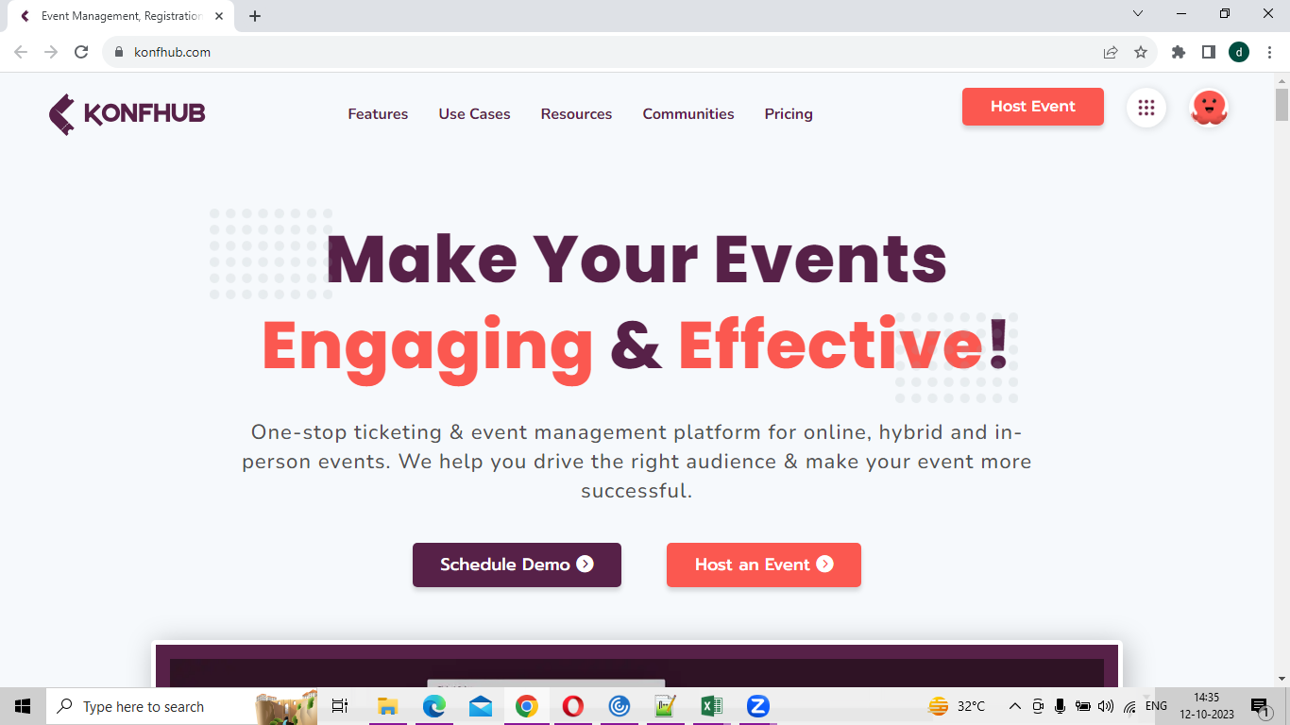
Register yourself at Konfhub…

